Slide 1
NAME :- Amaan Khalid ROLL NO :- 20P-0602 CLASS :- 1-A TEACHER :- Muhammad Yousaf ICT PRESENTATION # 2

Slide 2
HEART MONITORING T-SHIRT & CANCER DETECTING NEEDLE
Humans are always trying to increase their life span and also trying to live a healthy life and for this they are always developing new technologies. The above mentioned technologies Heart Monitoring T-Shirt and Cancer Detecting Needle are also to prolong and make human life better. Both the technology will help a lot in medical science because one of it can be used to monitor your heart rate without going to hospital and the other is used to detect cancer in your body.
If this technology is used wisely it can help a lot of humans.

Slide 3
YOUTUBE VIDEO LINK
The link to the video is You Tube

Slide 4
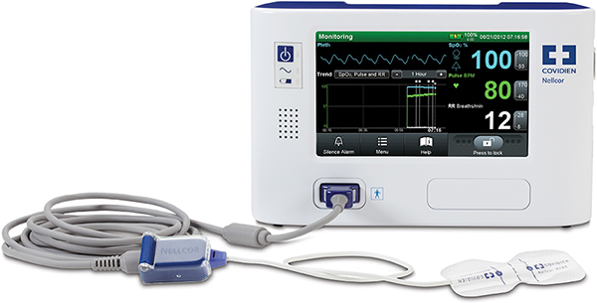
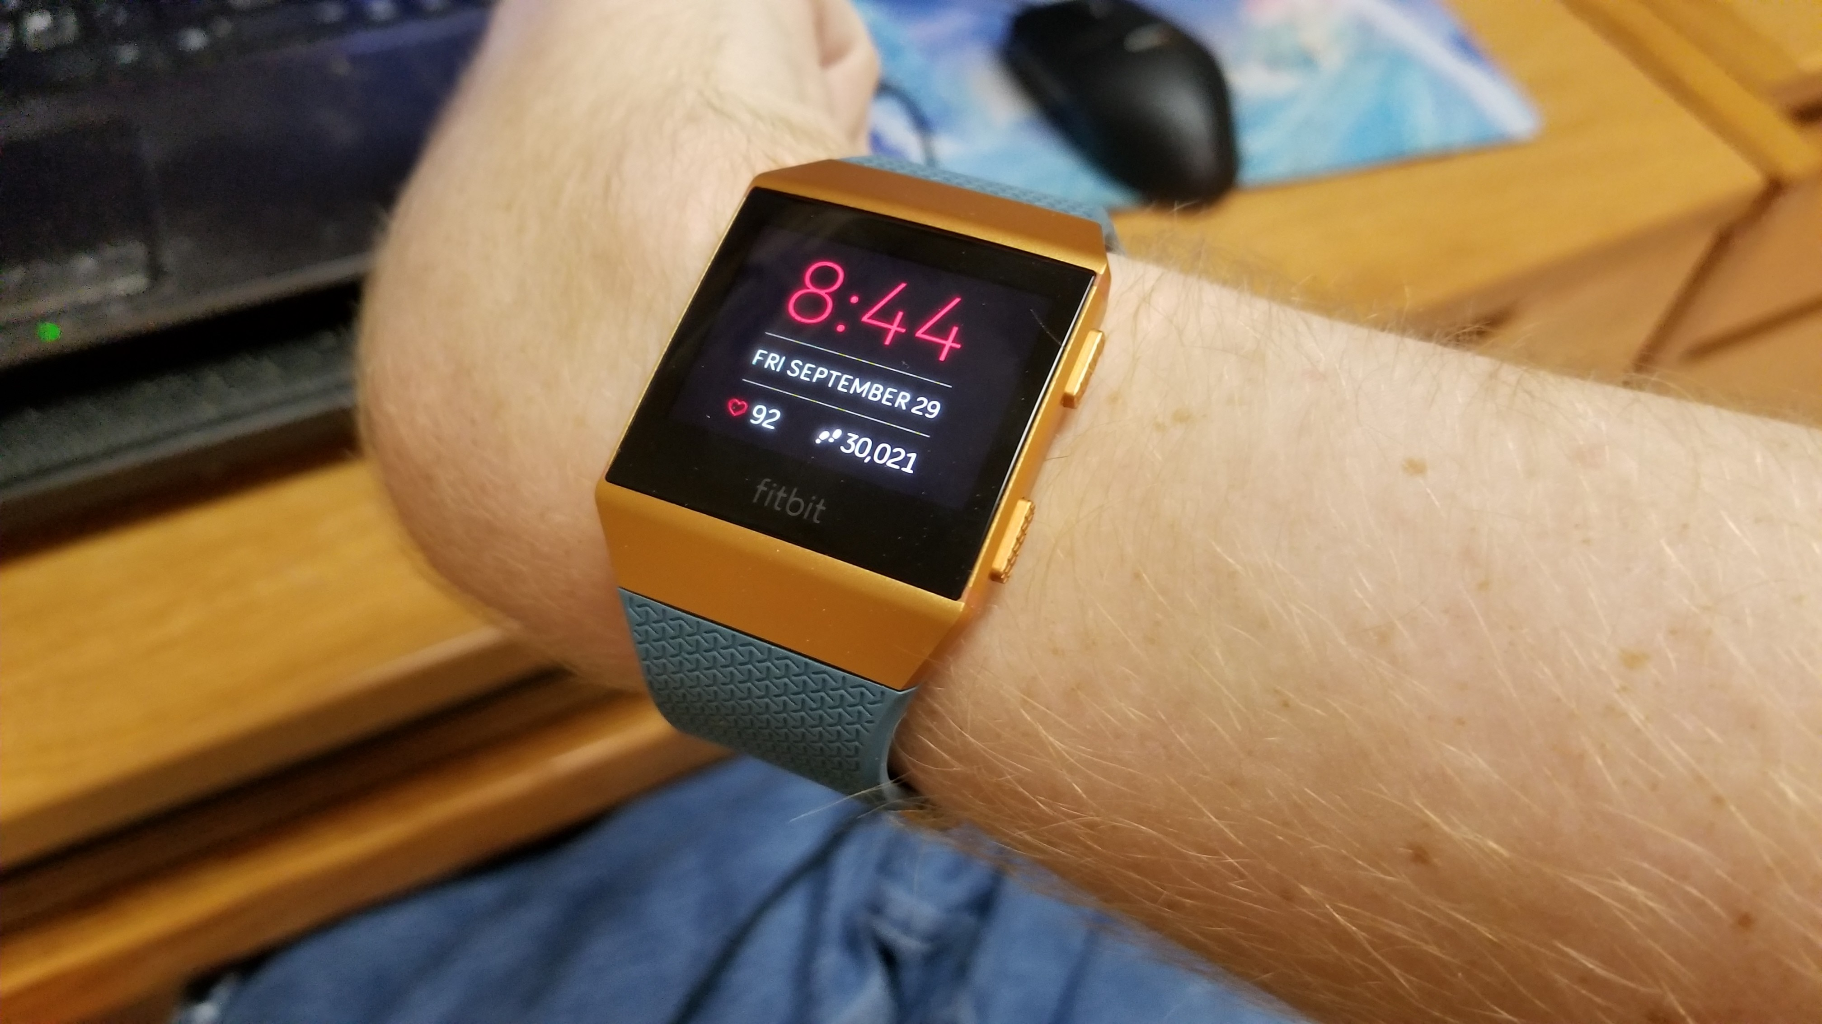
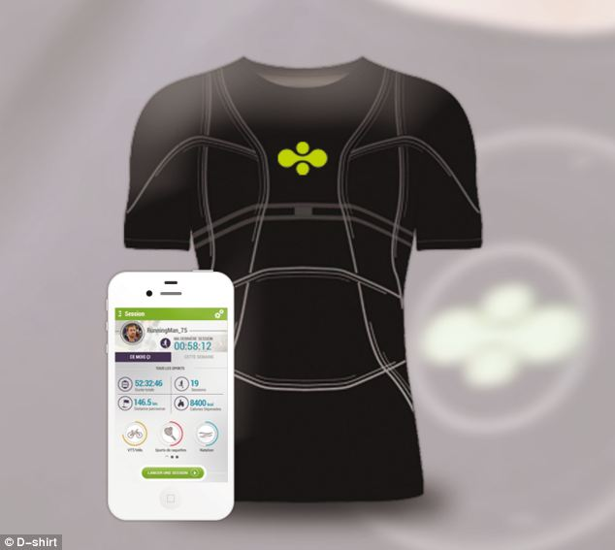
Heart MONITORING T-SHIRT
BACK GROUND
Heart Monitoring is one of the must test which must be taken to check the condition of heart in hospital.
Heart Monitoring was first made with a lot of things attached on the chest.
Heart monitoring then was put into Our Smart phones and Smart watches but they were not so much authentic and trust worthy.
The scientist in Spain in 2011 said that they have created a intelligent T-Shirt which could measure a persons heart beat and temperature.
The T-Shirt does not make the heart patients to be stuck on the bed but they can move freely and if they feel there is problem with the heart they can check on the spot and go to Hospital

Slide 5
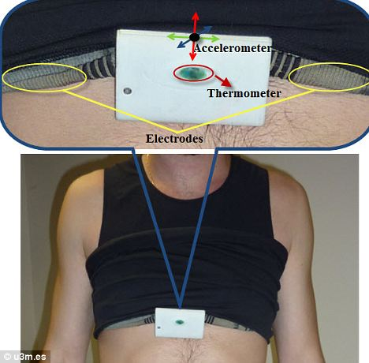
Heart MONITORING T-SHIRT
The smart clothing is made from conductive 'e-textiles' which have electrodes integrated into the fabric. This is used to measure a person's heart rate and can even take an ECG.
The raw data is collected by an 'acquisition device' (AD) worn around the neck under the T-shirt, which sends it on wirelessly to a management system, which interprets the results.
You just have to wear the shirt and the sensors will start automatically.
The Heart Monitoring Shirt is like a normal shirt you just have to wear it and there are no extra components the wires are fixed in such a way that you don’t feel mush of a difference.
The electrodes are on the chest which are used to calculate the heart beat data.

Slide 6
Benefits of Heart Monitoring T-Shirt
Heart Monitoring T-Shirt can be used to monitor a person heart beat any where.
The person does not need to be stuck in the bed.
It has more accurate reading than the smart watches and Smart phones.
Athletes can check there condition while running with better accuracy.
Heart Monitoring T-Shirt can help person know about his heart condition on basis of which he can know when to visit the hospital.

Slide 7
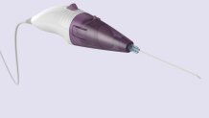
CANCER DETECTING NEEDLE
BACK GROUND
Cancer detecting needle was developed by multidisciplinary teams of experts
The team has proved that the needle can differentiate between healthy and diseased tissue by demonstrating its accuracy in 68 patients sample test with in the laboratory.
Professor Nick Stone from the university of Exeter is the project lead and he said “The Raman smart needle can measure the molecular changes associated with disease in tissues and cells at the end of the needle. Provided we can reach a lump or bump of interest with the needle tip, we should be able to assess if it is healthy or not.”
The first prototype was created by Dr John Day of the University of Bristol’s School of Physics and he continues to work on optimizing the design if the needle.

Slide 8
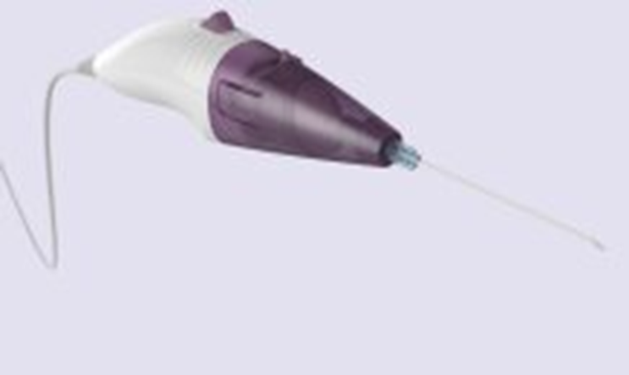
CANCER DETECTING NEEDLE
Cancer detecting needle is a new techniques in medical sciences because as in the name the needle can be used to find out if there are any kind of cancer cells in the body.
The needle uses a technique known as Raman Spectroscopy in which the light scattered by tissues when a low-power laser is shone onto it. Light is scattered differently from healthy or diseased tissues with the help of which the doctors can detect the presence of cancer in the matter of seconds.
The needle can detect most common kinds of cancer cells in seconds which will take around 2 weeks to be identified by the Laboratory.
The needle can be used to find out cancers cells in any part of the body.

Slide 9
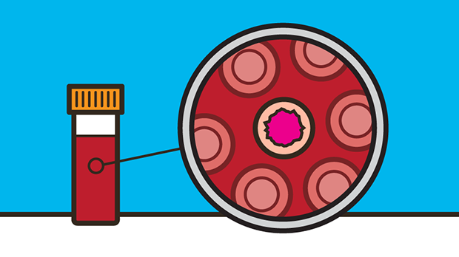
Benefits of Cancer Detecting Needle
There are many benefits of Cancer detecting needles.
The needle can detect the cells faster as compared to Laboratory.
More people can be saved as compared to before.
The people don’t have to wait so long to start there treatment when they can know instantly that they have Cancer.
This can be considered cheaper as compared to the laboratory test where you have to give different samples to get checked if you have activated cancer cells in your body.

Slide 10
FOR ANY KIND OF QUERY
You can mail me on p200602@pwr.nu.edu.pk .

Slide 11
THE END

